Slide 1
The early BiRD (Biannual Rounds of Drugs) gets the worm(s)
The Geshiyaro Project: control programme in southern Ethiopia defining the endgame for STH and SCH control
Notes:
I work for the Geshiyaro project, which has been designed to define the endgame for STH and SCH control.

Slide 2
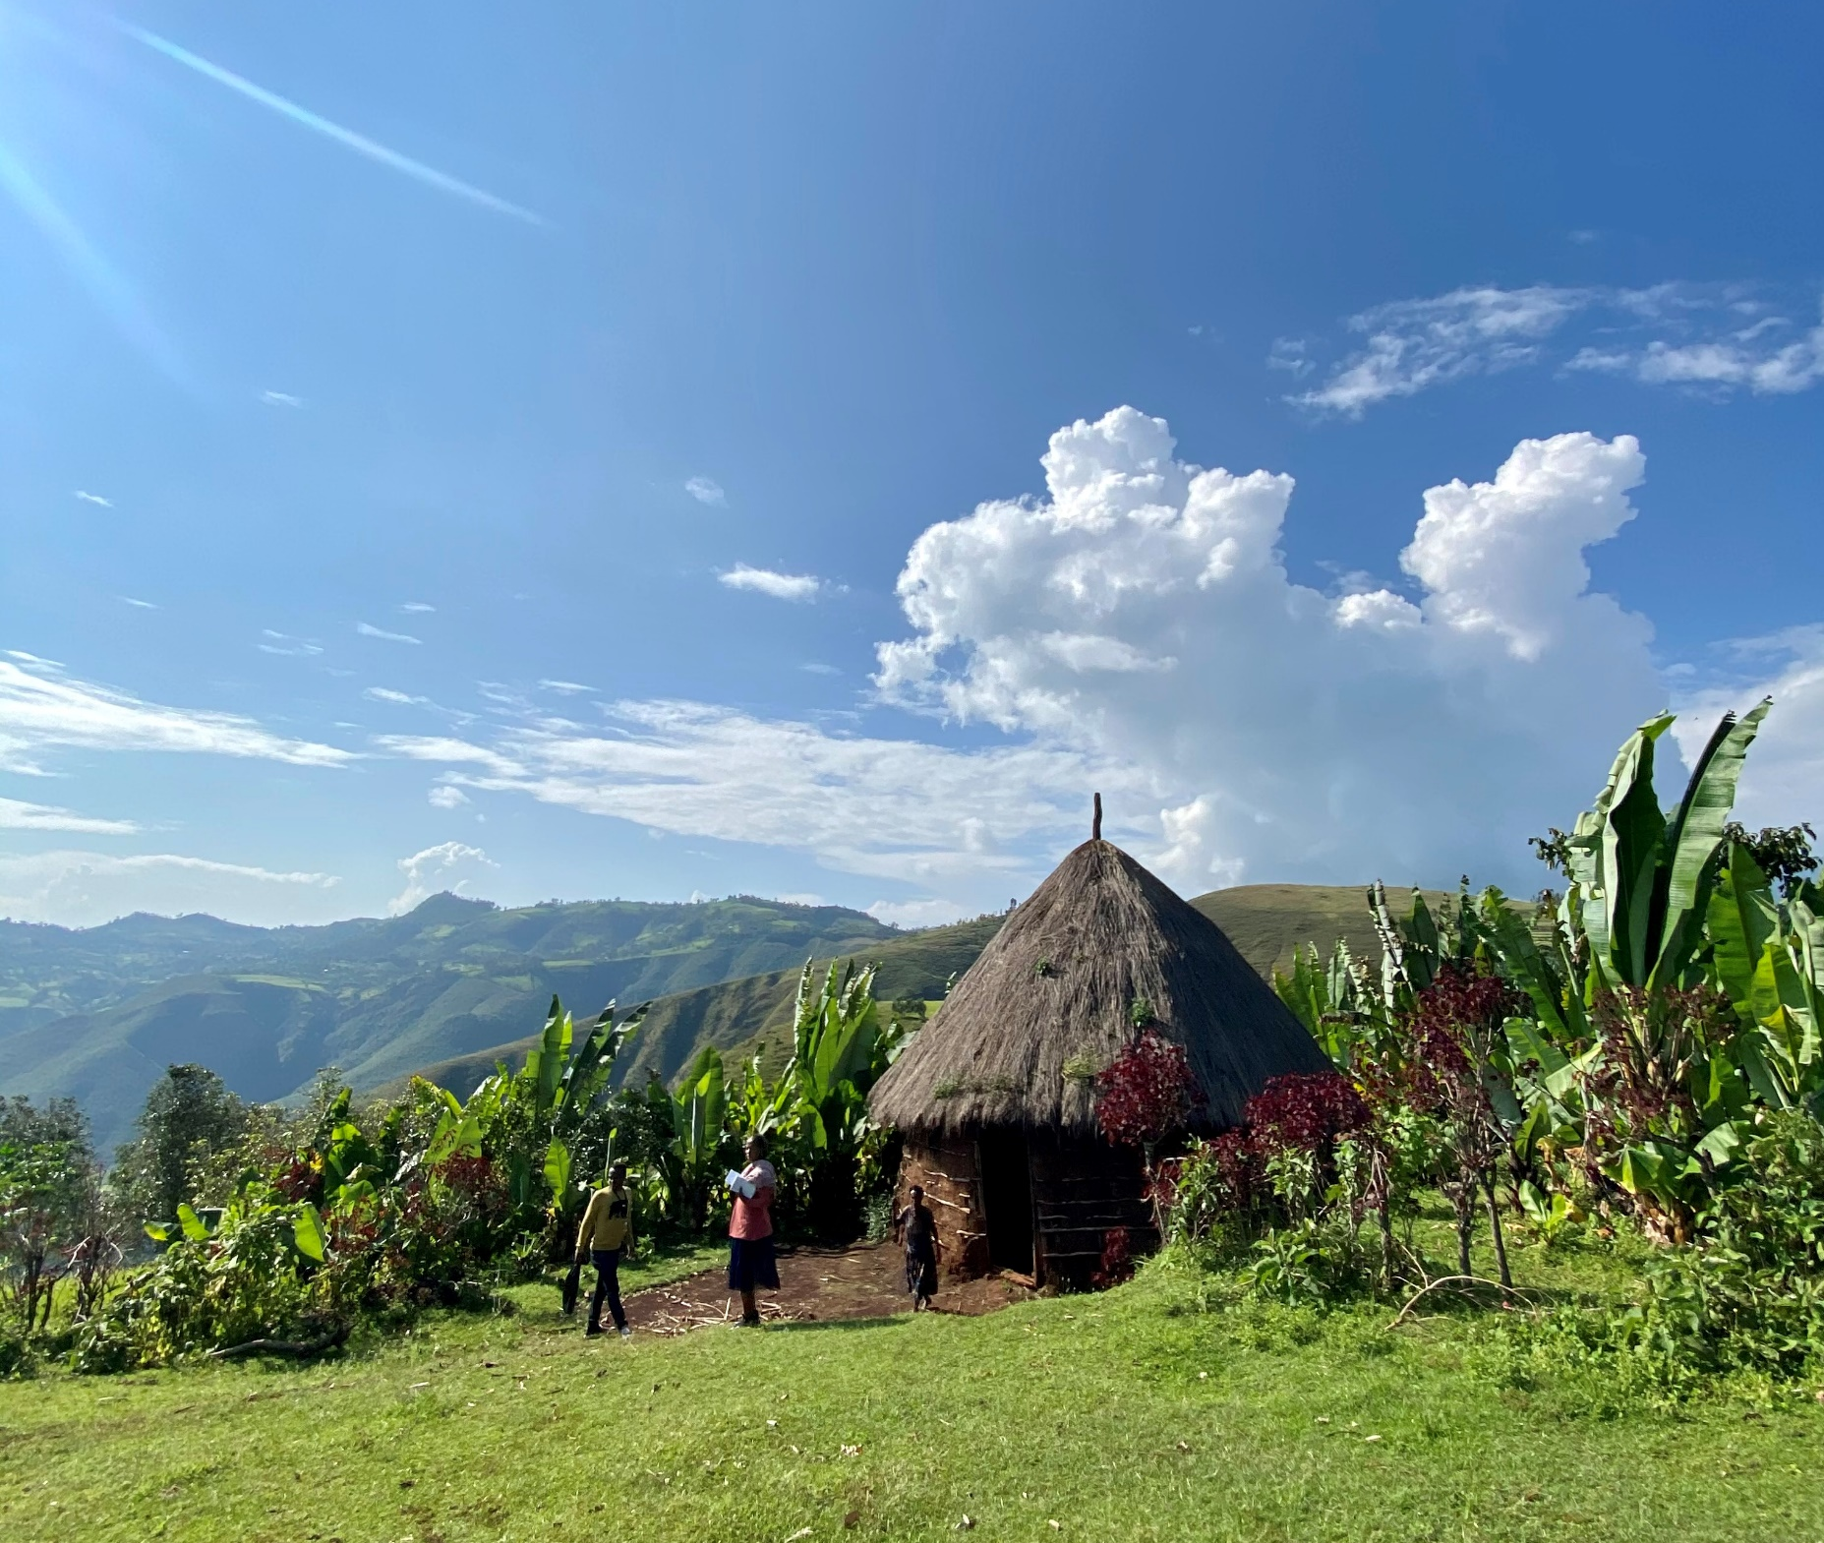
Location
The Geshiyaro project is based in the Wolaita zone in southern Ethiopia
Three arms to study control of STH/SCH
Arm 1:
Expanded community-based MDA
WaSH interventions with BCC
Arm 2:
Expanded community-based MDA
Standard One WaSH national programme
Arm 3:
Standard national SAC-based MDA
Standard One WaSH national programme
Subsample followed longitudinally in our sentinel sites
boundary of each intervention Arm
Notes:
The Geshiyaro project is based in the Wolaita zone in southern Ethiopia, this zone is divided into two of the three intervention arms of the project:
I will present data from our Arm 1 site, which receives community based treatment, alongside WaSH interventions delivered with behaviour change communication
Arm 2 receives just community based treatment and Arm 3 (shown as the cluster on the right in a neighbouring zone) is our control
A subsample of the population in these sites are followed annually for parasitological mapping.
By implementing community-based treatment, we are aiming to avoid the two main pitfalls of SAC-based treatment.

Slide 3
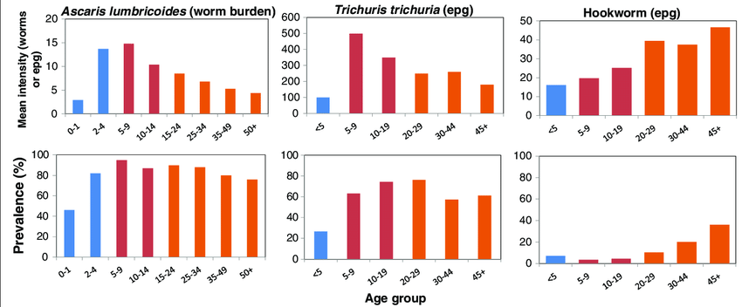
Age-prevalence distribution – reservoirs of infection
If programmes just treat school aged children…
Create reservoirs in adult cohorts, who can re-infect the treated children (MDA ≠ immunity)
The majority of hookworm (80%) and Strongyloides burden will be missed
Figure adapted from: Can chemotherapy alone eliminate the transmission of soil transmitted helminths? Truscott et al. (2014)
Notes:
The first being directly related to the age-prevalence distribution for STH and SCH species. Generally the majority of parasite burden is found in SAC, as such WHO recommends targeted treatment of this group. However the untreated adults act as a reservoir of infection, undoing the work of previous MDA rounds. MDA does not confer immunity and so avoiding reinfection is important.
Secondly, this treatment strategy only suits Ascaris and trichuris – as 70% of parasite burden is found in children. Conversely, 80% of hookworm burden is found in adults so only when employing community based treatment does the majority of parasite burden get treated!

Slide 4
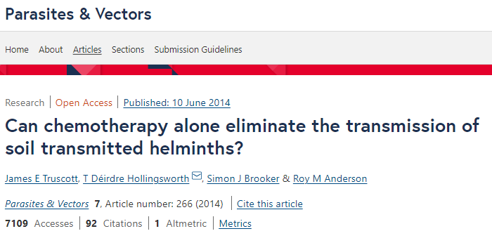
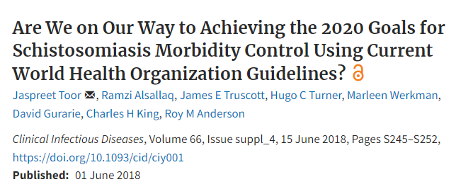
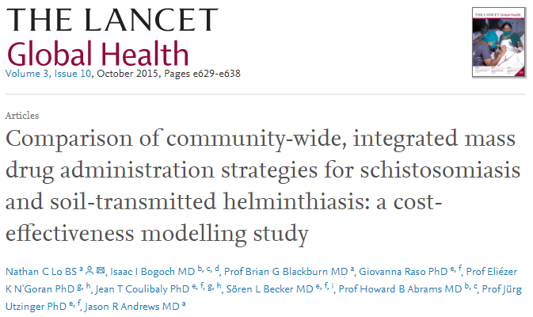
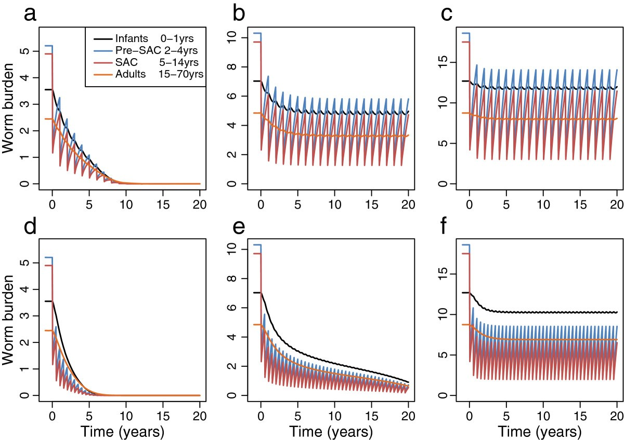
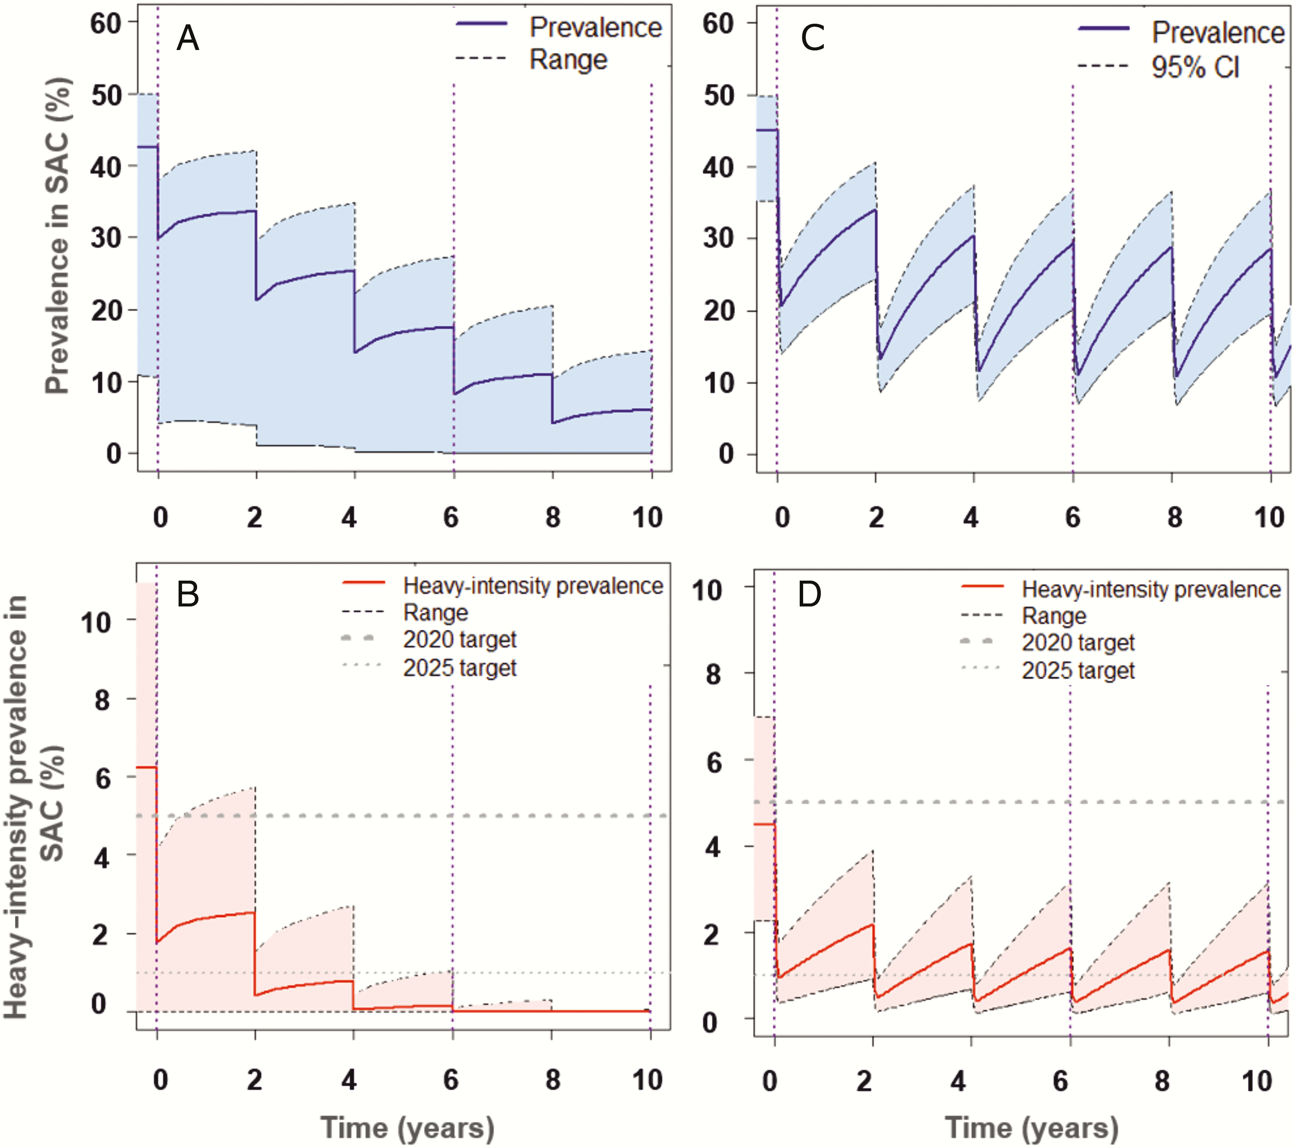
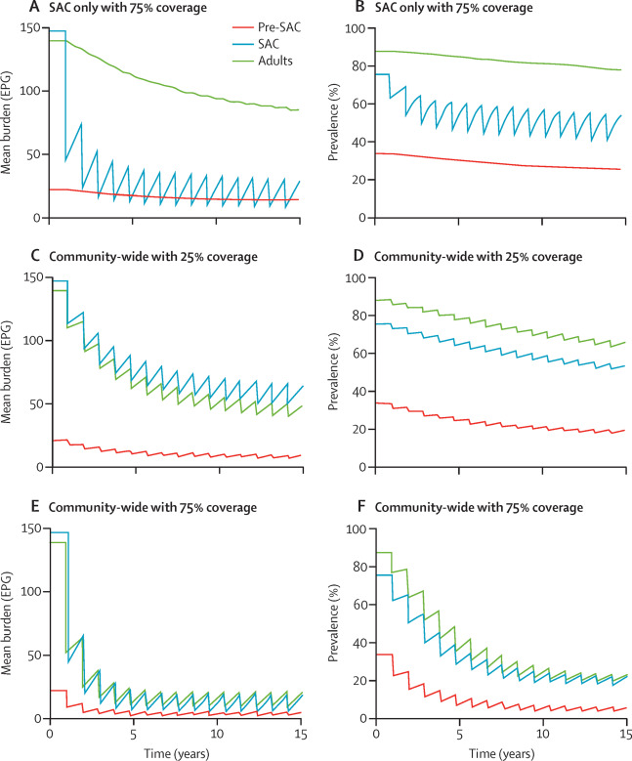
Notes:
The issues with SAC-based treatment have been flagged, modelled and reported across multiple groups and settings – and have come to the consensus that

Slide 5
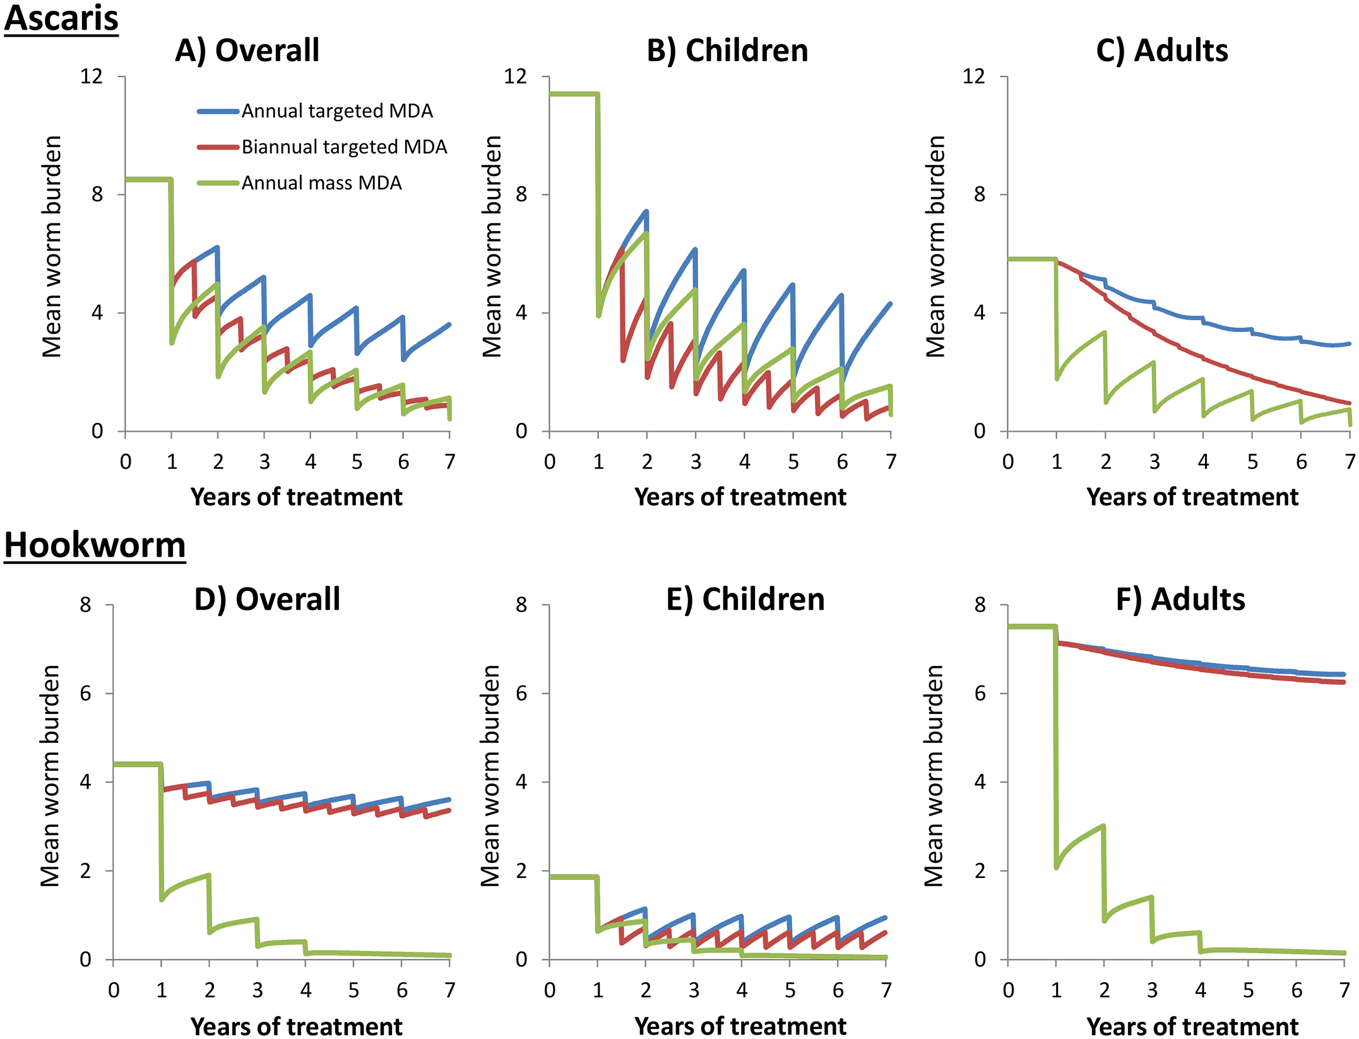
Widening treatment age groups
School-based treatment will not reach transmission break, requiring indefinite MDA.
Community-based treatment increases chance of transmission break, treats reservoir in adults, and majority of hookworm burden finally get treated.
Figure from: Should the goal for the treatment of soil transmitted helminths (STH) infections be changed from morbidity control in children to community-wide transmission elimination? Anderson et al. (2015)
Notes:
that exclusively using SBT will require infinite rounds of MDA, and transmission break wont be reached
The suggestion is, by widening the age groups receiving MDA, transmission break will have a chance of a look in.
But is it possible?

Slide 6
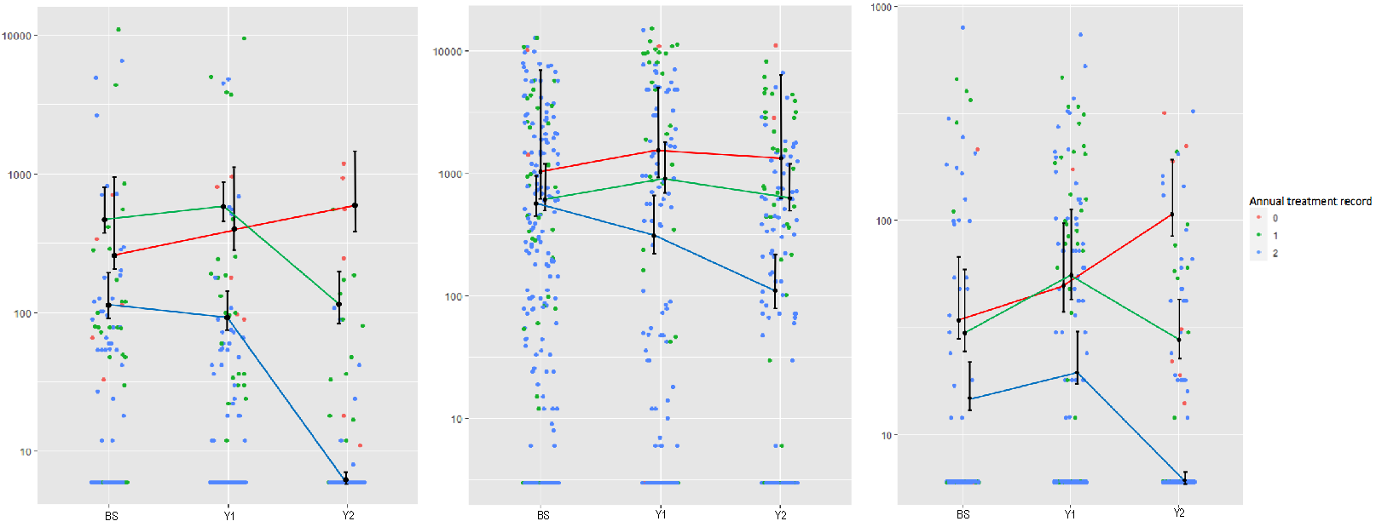
Prevalence over three years
Our data shows a significant decrease in mean epg between individuals that swallow treatment each year, compared to those who partially, or never swallow treatment.
Highlights the issue of individual behaviour at MDA – systematic non-treated population will challenge transmission break goal.
Eggs per gram (epg)
T. trichiura
A. lumbricoides
Hookworm
Figure from: Longitudinal monitoring of the prevalence and intensity of soil-transmitted helminth infections in individuals who were either treated or not treated following repeated rounds of community-wide mass drug administration within the Geshiyaro project in the Bolosso Sore district, Wolaita, Ethiopia. Landeryou et al. (2022) [PREPRINT]
Notes:
Our project is in its 4th year of operation, and we now have three years of clean data to play with.
This is figure taken from our sentinel sites in Arm 1 and shows how individuals who swallowed treatment all three rounds of MDA have significantly reduced their intensity of infection, compared to those who partially or never swallowed treatment.
Although the blue line tells a story of success, the red and green highlight the issue of systematic non-treatment or partial treatment. Looking at individual behaviour across treatment rounds will be beneficial in defining these cohorts allowing us to find and reach them in the future. Luckily for us we have this data!

Slide 7
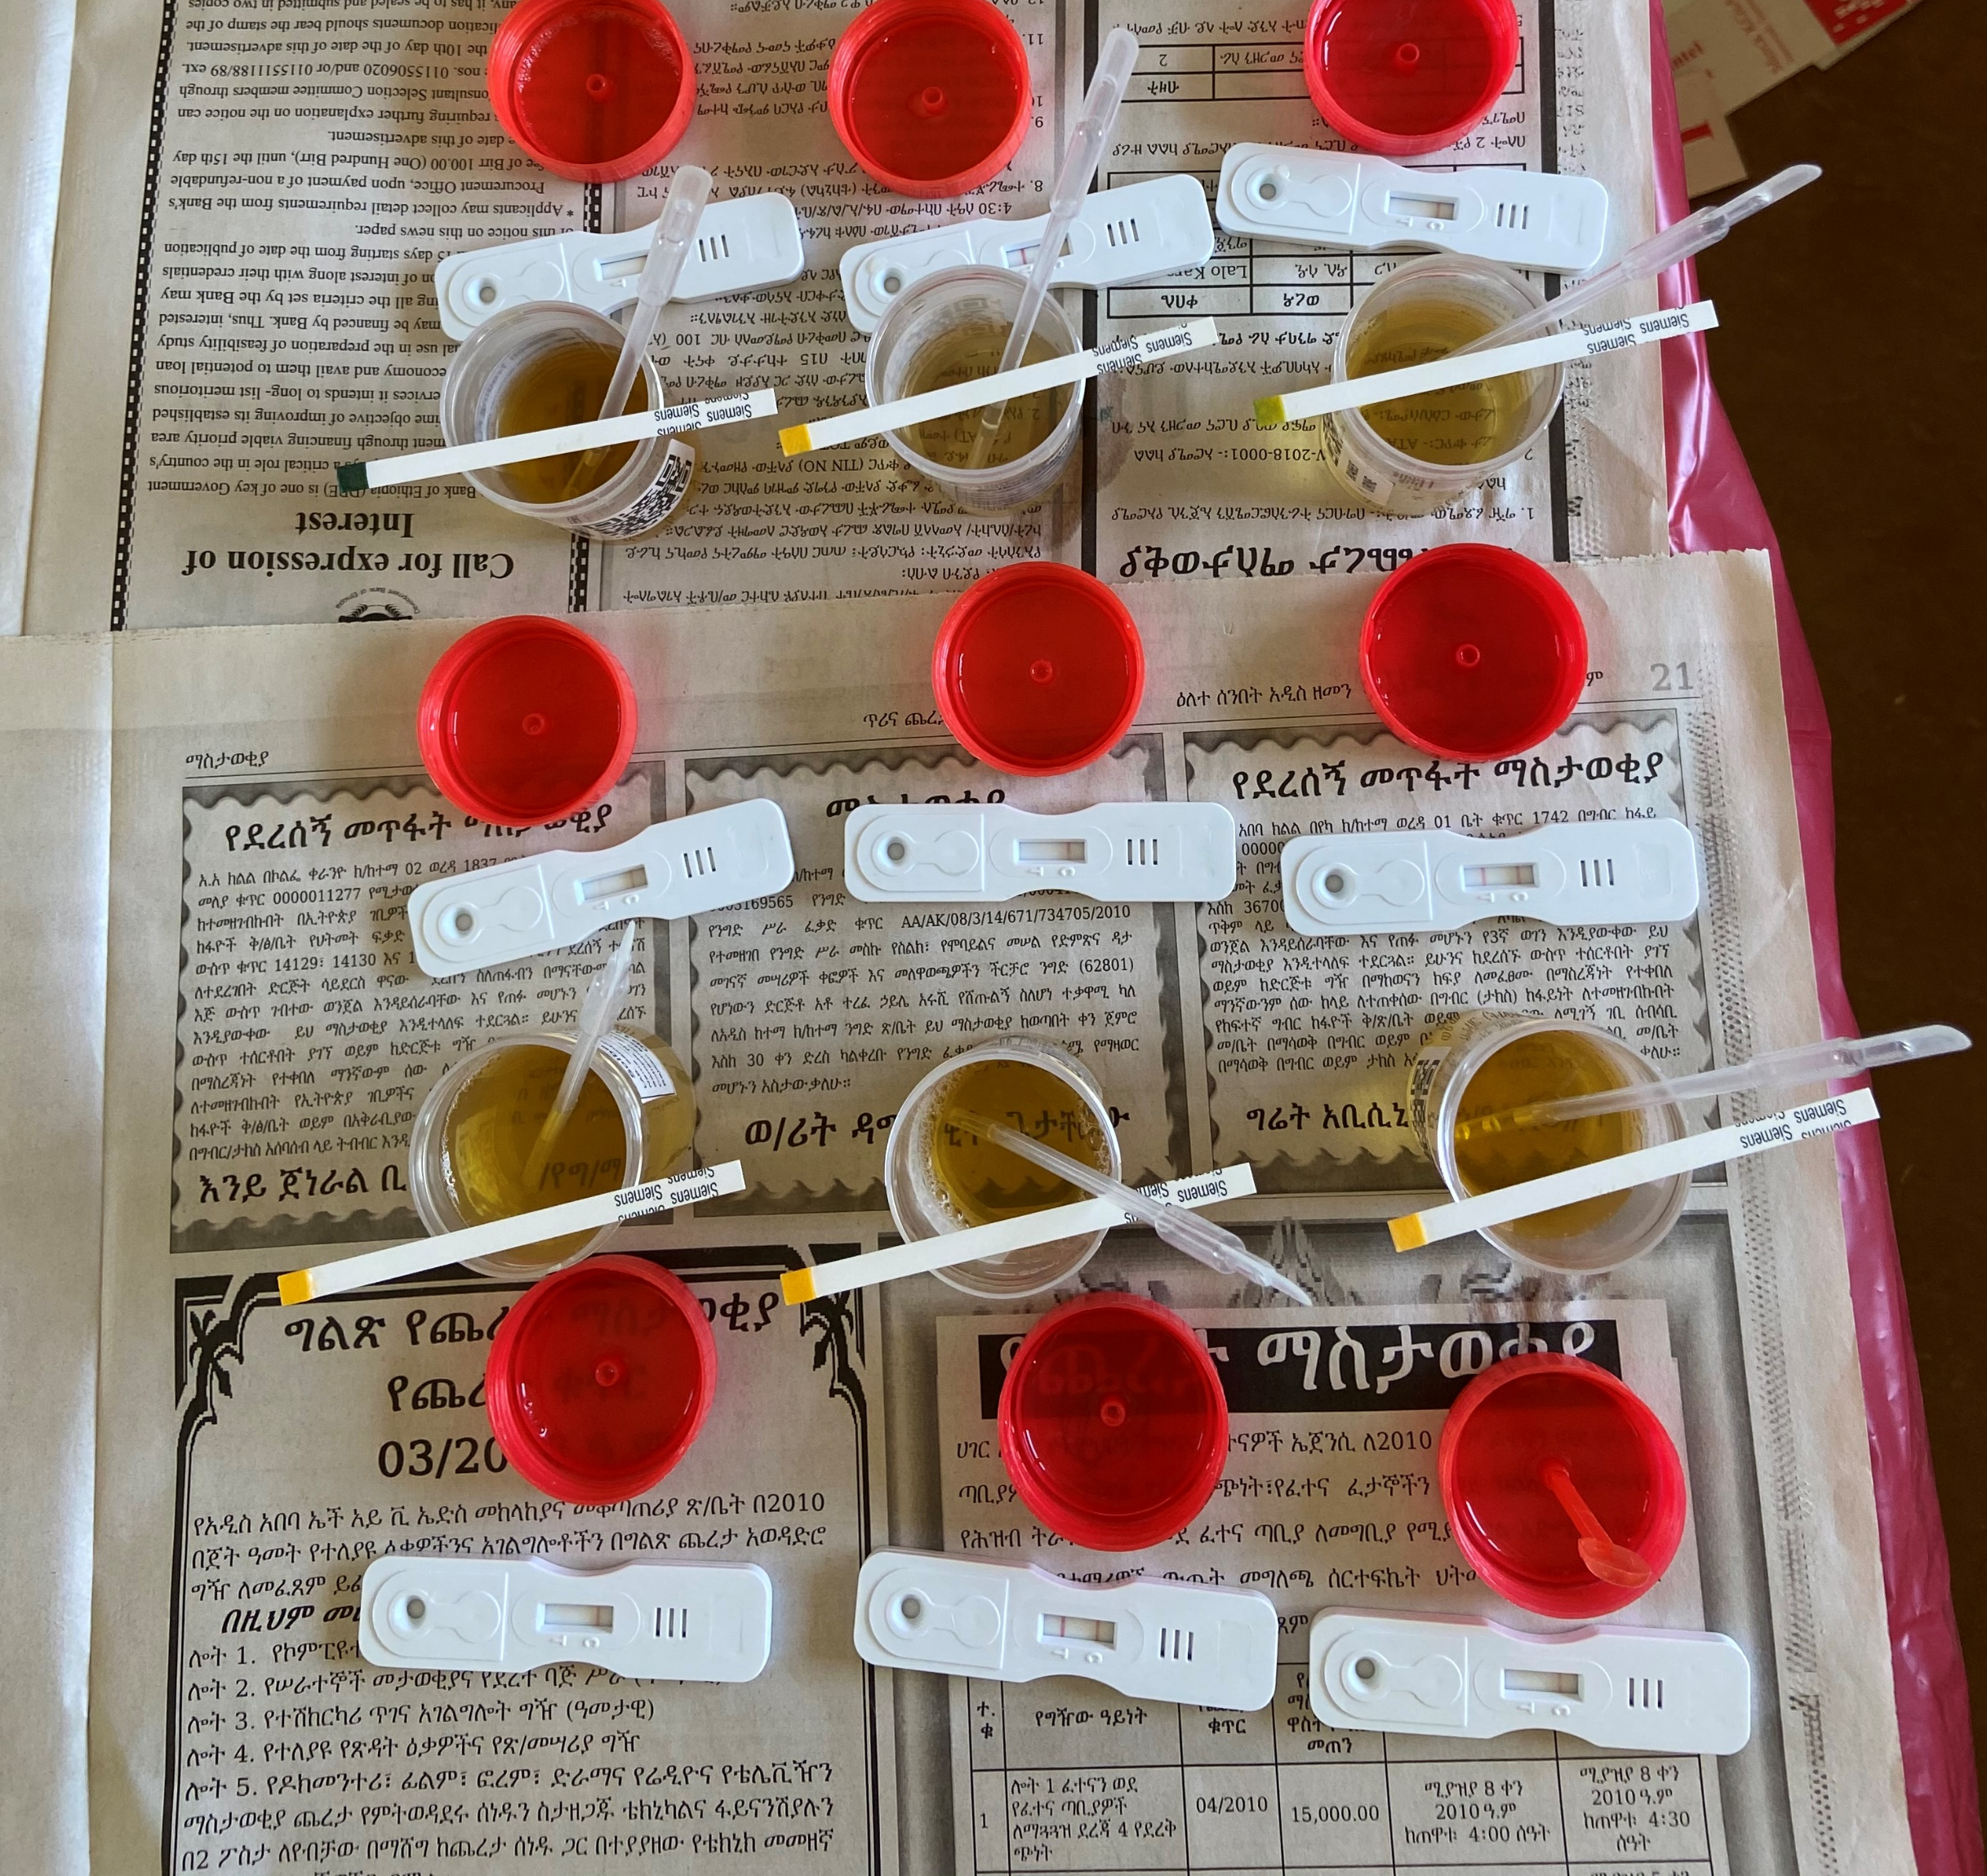
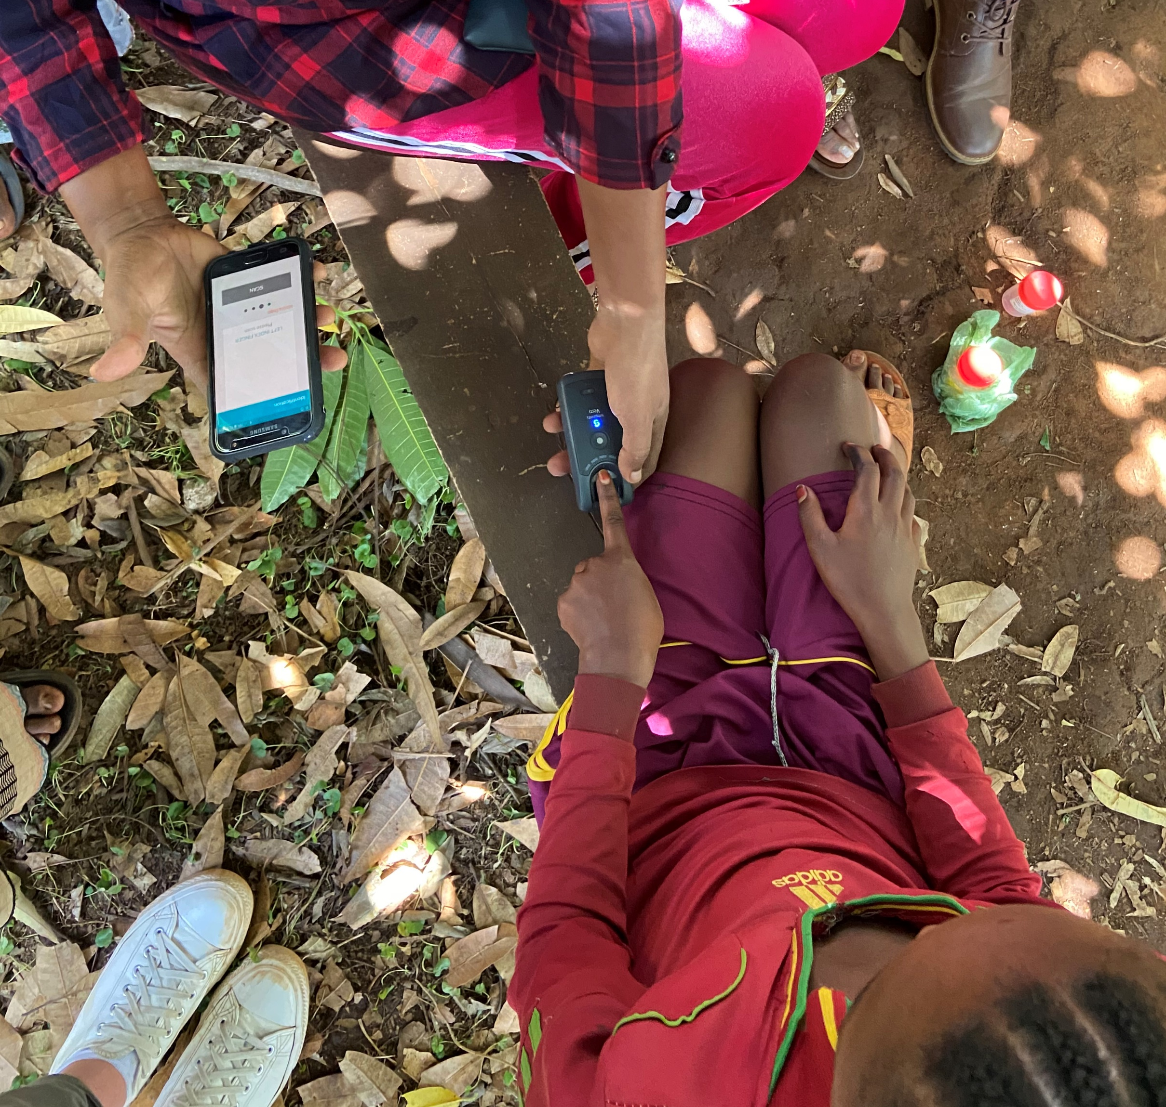
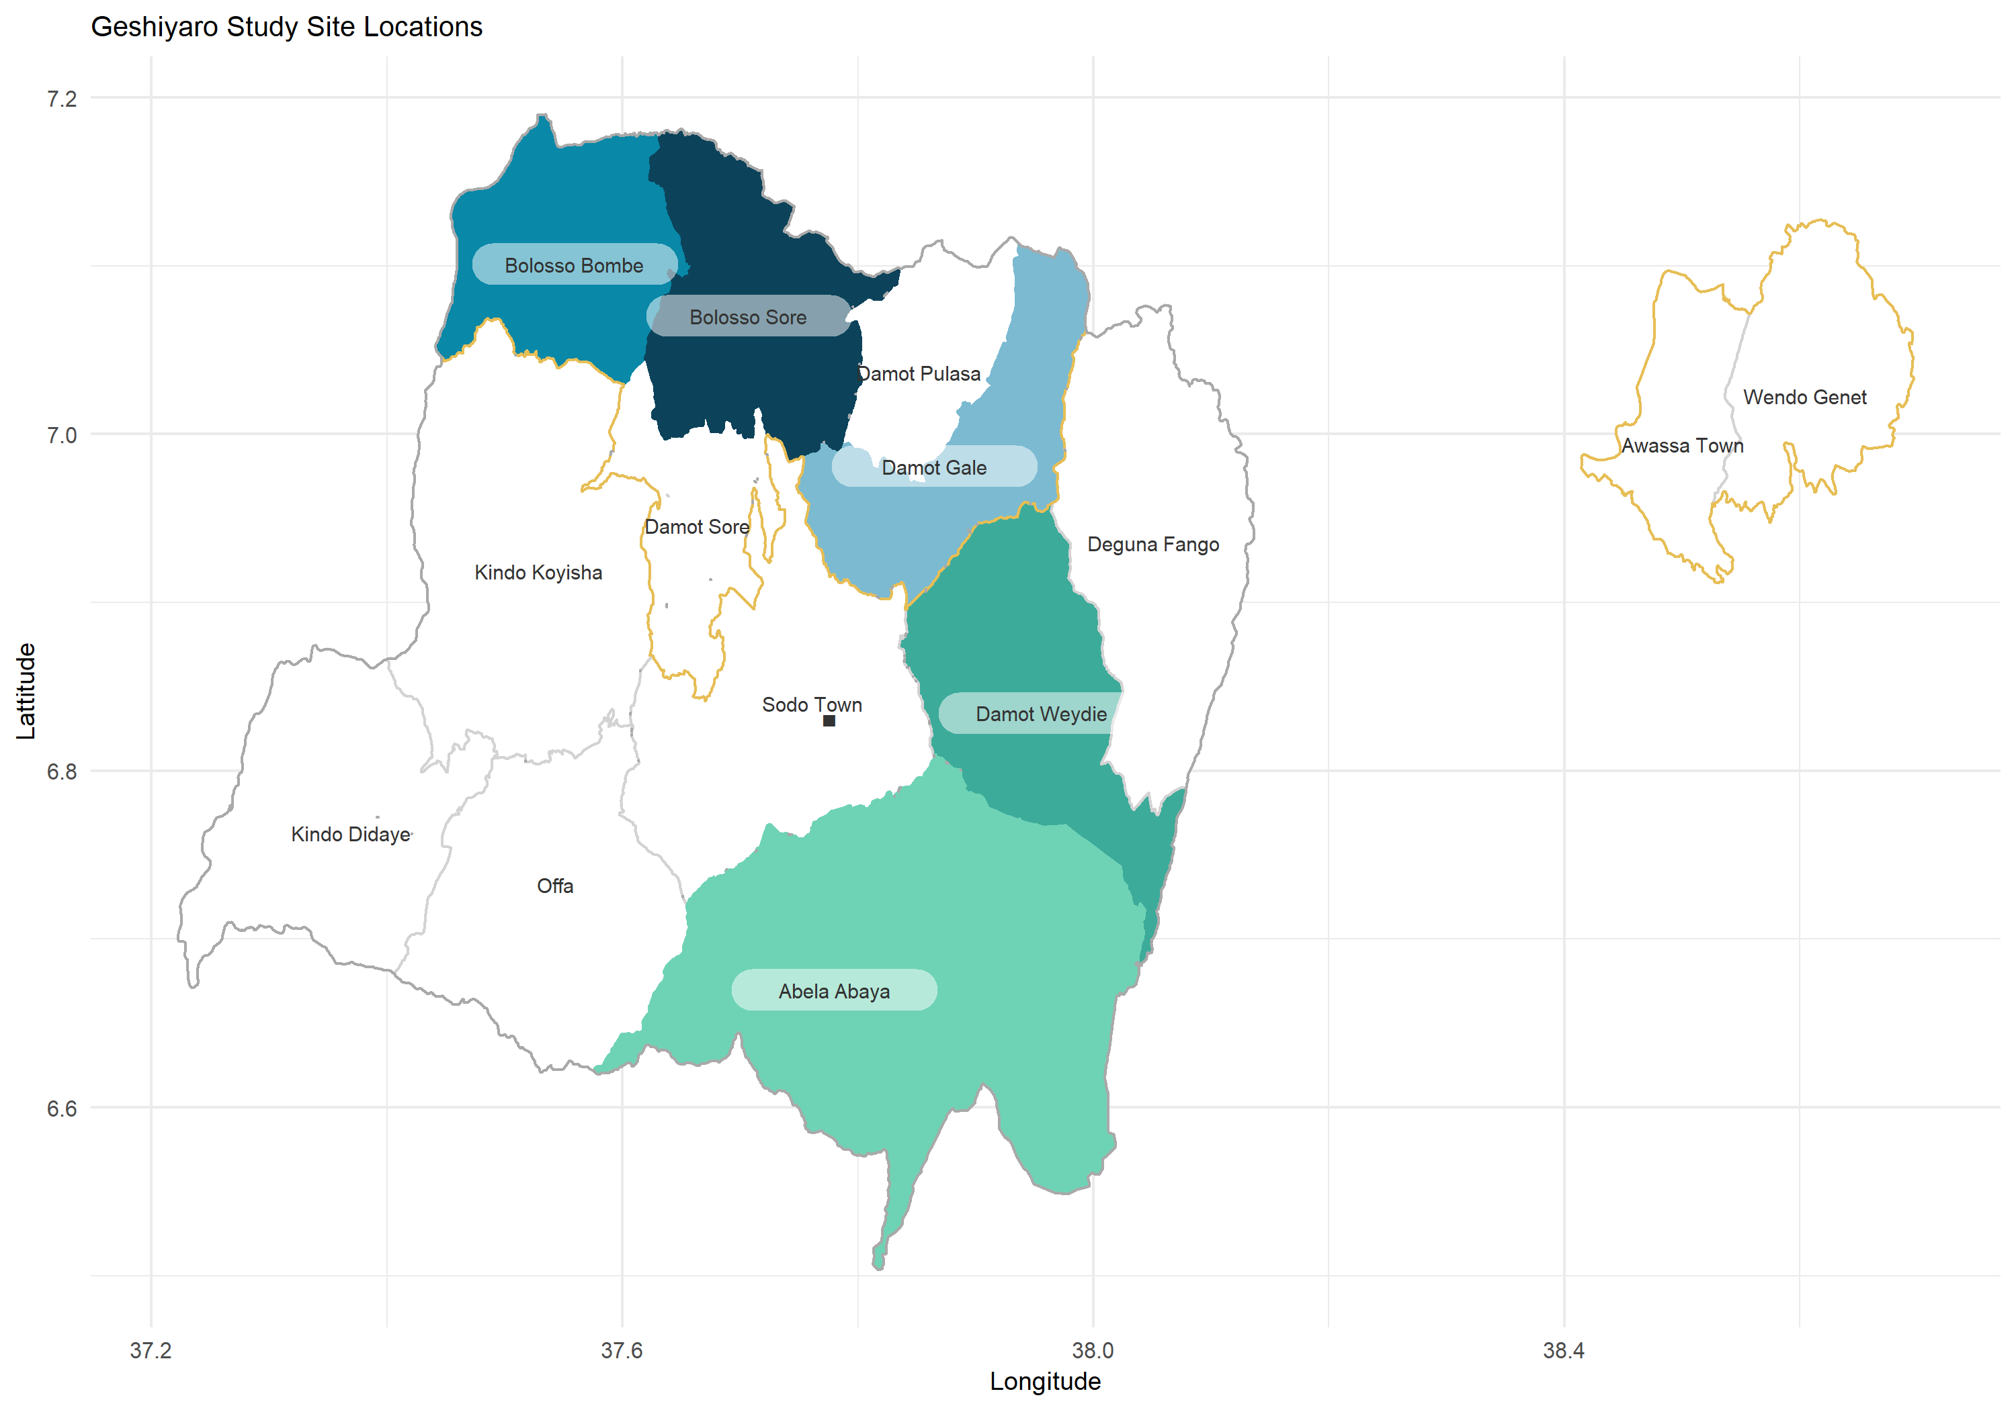
Individual level data
Baseline census taken at the start of the project (biometrics taken in highlighted woredas)
All participants in highlighted woredas are followed each year at MDA
Sentinel sites from all Arms followed annually
Parasitological mapping – diagnostics
Interaction with MDA
WaSH survey
Notes:
We took a census at the start of the project in a sample of woredas highlighted here and recorded baseline demographics, access to WaSH, and parasite prevalence. This information is all tracked using biometric fingerprinting.
Therefore anytime our data collectors contact an enrolled participant whether it be during sentinel site parasitological mapping or MDA, we can follow their data longitudinally. This is important for MDA monitoring and evaluation.

Slide 8
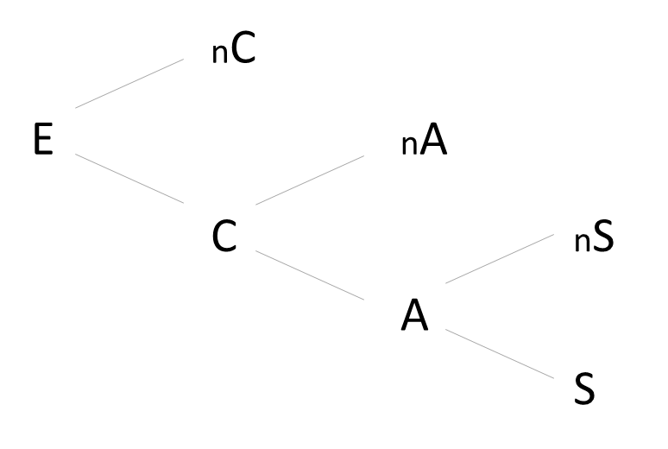
Compliance over three rounds of MDA
Treatment outcome can be thought of as the result of three behaviour points that eligible participants can pass through at each round of MDA.
Broadly the population can be divided thrice into
a) was a participant contacted or not?
…if yes then
b) Did they accept treatment
… if yes then
c) did they swallow or refuse treatment?
Notes:
From the responses recorded at MDA using this biometric monitoring, we can divide our population into a) b) c)
From our census, we know who our eligible population is, and pulling our treatment data against this population we can see how the population passed along this flow diagram.
Turning MDA treatment behaviour into a conditional probability decision tree, we can look at the probability of swallowing treatment, against different demographic factors.

Slide 9
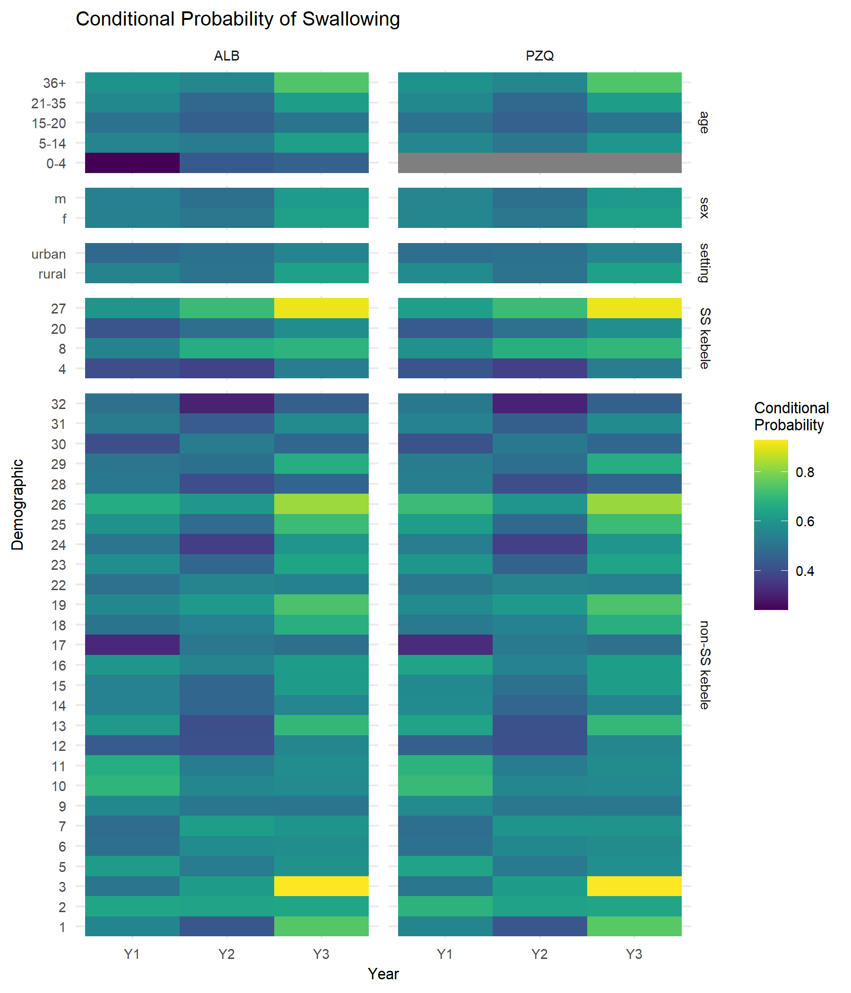
Compliance over three rounds of MDA
age
Individuals in our sentinel sites were more likely to swallow treatment
Conditional probability of swallowing increases with age
The number of people swallowing treatment increased over time
sex
urban / rural
sentinel site
non- sentinel site
Notes:
From here, we can then start to build a picture of the cohort at each part of the decision tree.
For example, individuals enrolled in our sentinel sites are on average more likely to swallow treatment.
The conditional probability of swallowing increases with age.
Thankfully, the probability of swallowing ALB and PZQ has increased over time

Slide 10
Compliance over three rounds of MDA
Contacted
vs. not contacted
Contacted, accepted and swallowed treatment vs. contacted and refused
Notes:
Dividing treatment behaviour instead into two groups, we conducted multiple logistic regression on the contacted versus not contacted population and the contacted, accepted/swallowed vs. contacted and refused population.
We can see some interesting trends such as
The adjusted odds of being contacted increased with age, whereas once contacted, the odds of swallowing increased to a lesser extent
Urban populations were less likely to be reached than their rural counterparts, yet were more likely to swallow the treatment once reached

Slide 11
The future
Immediate future – this information can be used to
Inform our drug distributors the population missed
Inform our MDA sensitisation activities for those who refuse treatment
This will improve our chances of increasing coverage and compliance
Long term – share this information with similar projects so they too can improve MDA coverage and reach populations currently missed for treatment
Notes:
As we follow the final 2 remaining years of the project, we will be able to build a stronger picture of the treatment behaviour at MDA.
In the short term, we can use these findings to feed back information to our drug distributors to help them increase the drug coverage and reach more participants.
Long term, we can share our findings with similar projects

Slide 12
With thanks to all project partners
Ewnetu Firdawek
Melkie Chernet
Habtamu Belay
Yonas Belachew
Hussein Mohammed
Tujuba Tenderias
Roy Anderson
Kathryn Forbes
Tina Rouse
James Truscott
Birhan Mengistu
Santi Rayment Gomez
Rosie Maddren
Adugna Tamiru
Ufaysa Anjulo
Desalegn Tadele
Anindya Sharma
Notes:
Thank you of course to the huge team that work on the Geshiyaro project, and thank you for listening to my quick synopsis of the project!

